Slide 1

Managing Stress
The importance of self care and how it affects your mental health
Kristie Collins, LPC, LMFT
Associate Director for the Counseling Center @TTUHSC
Notes:
Managing Stress: The Importance of Self Care and How it Affects Your Mental Health.

Slide 2


What is Self care and how does it affect your mental health?
Mental health is the successful performance of mental function.
The term self-care describes the actions that an individual might take in order to reach optimal physical and mental health. Self-care can also refer to activities that an individual engages in to relax or attain emotional well-being, such as meditating, journaling, or visiting a counselor.
Intentionality
Notes:
Question: What is self care and how does it impact your mental health? Mental health is the successful performance of mental function.
The term self-care describes the actions that an individual might take in order to reach optimal physical and mental health. Self-care can also refer to activities that an individual engages in to relax or attain emotional well-being, such as meditating, journaling, or visiting a counselor.
It is important to note that self-care for most of us involves INTENTIONALITY

Slide 3
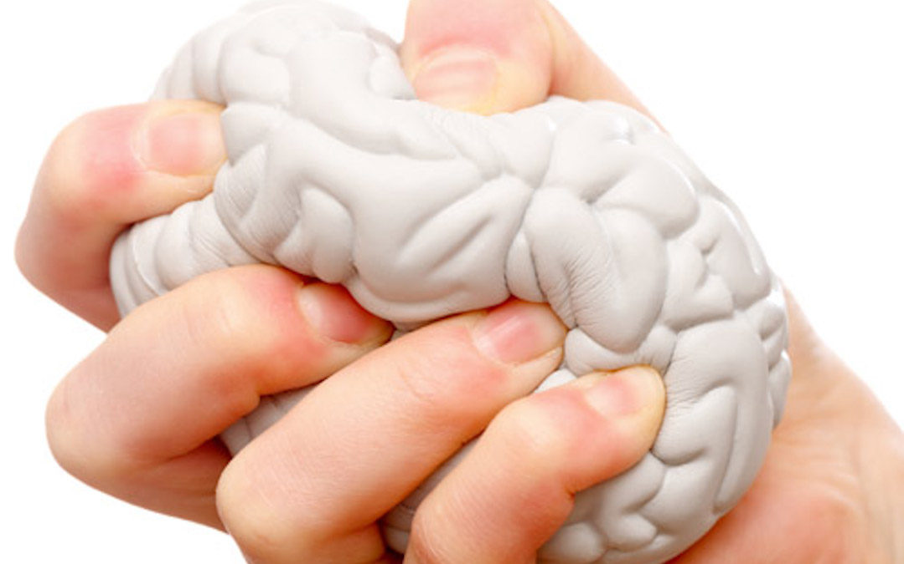
Unmanaged
Stress
Unmanaged
Anxiety
Depression
Learn to manage your stress!
It’s not simple or easy but
it is possible.
Notes:
I believe the answer to managing stress is self care and self talk but before we discuss this, I want to take a look at the relationship between stress, anxiety, and depression. As you can see in the diagram, (CLICK) unmanaged stress becomes anxiety, (CLICK) unmanaged anxiety becomes depression. (CLICK)
–Dr. Curt Thompson, a neuro-psychiatrist says depression becomes a symptom of the anxiety I can not manage. (Repeat)
(CLICK) One of the best solutions to managing your anxiety or your depression is to learn to manage your stress. This is not simple or easy but it is doable, in fact, learning to manage stress is critical to our well being, both mentally and physically.
*Stress continuum courtesy of Kristie Collins
*Brain image courtesy of https://blog.usejournal.com/failure-of-self-care-40b2c0c9542d

Slide 4
Anxiety is a physiological response
Performance
Beneficial
Resource
Blessing
Harmful
Liability
Curse
Anxiety
Notes:
The management of anxiety and stress is key! However, it’s important to understand that anxiety has a direct relationship to our performance. It is much like the bell curve pictured here. (CLICK) On one side it is beneficial, a resource, a blessing. As anxiety increases so does performance. (CLICK) On the other side it is harmful, a liability, a curse. On this side of the curve performance starts to decrease. I am sure you have experienced both sides of this curve. Anxiety, like food, is not something you can simply get rid of. As you can see it takes anxiety to have high performance. Olympic athletes are trained to operate in the (CLICK) green zone. However, if you are performing at an optimal level, you are very close to crossing the line were it then begins to cause negative symptoms.
*Image courtesy of Kristie Collins

Slide 5
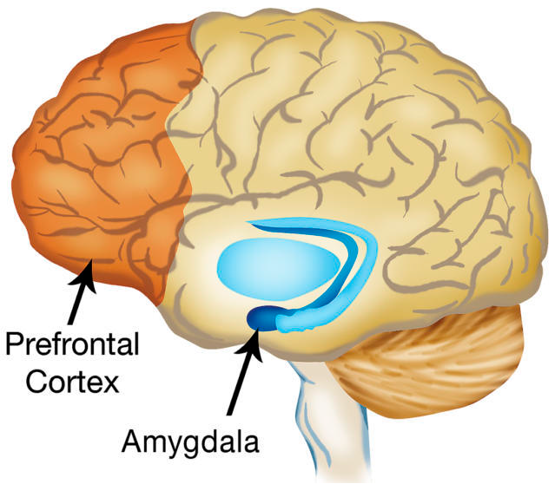
Anxiety is a physical response
Prefrontal Cortex: part of “higher” functioning, meaning it is used to:
Define
Create
Respond
Plan
Reason
Judge
Amygdala: involved in processing emotions, and fear-learning. It links areas of the prefrontal cortex to the brainstem systems.
Smoke detector
Fight/Flight or Freeze response
Notes:
Anxiety is a physical response. Now, I want you to think about the brain having 2 parts, human and animal. The (CLICK) human part of the brain, or the prefrontal cortex is the rational part of the brain. It is used to define, create, respond, plan, reason, and judge. Where as, the (CLICK) animal part of the brain or the limbic system is more emotional. The limbic system includes the thalamus and the amygdala which you can see are blue in our diagram. It is our smoke detector or our fight/flight and freeze response.
You can also think in terms of a horse and rider. The horse or limbic part of the brain is strong and powerful but needs the rider or prefrontal cortex to reign in that strength. Now lets look at the limbic system a little closer:
When faced with a threatening situation, our thalamus, which receives incoming stimuli, sends signals to both the amygdala and the cortex.
If the amygdala senses danger, it instantly begins the fight-or-flight response before the cortex has time to overrule it.
This triggers the release of adrenaline (epinephrine), which leads to increased heart rate, blood pressure, and breathing. You may experience a racing heart, shaking, sweating, and nausea as this happens.
In this way, the (CLICK) amygdala triggers a sudden and intense unconscious emotional response that shuts off the cortex, making it hard for you to think clearly about the situation. As your brain triggers the release of stress hormones such as cortisol, you find it increasingly hard to problem solve and concentrate. This whole process takes a toll, and you may not recover to your original level of functioning for several hours.
In more simple terms: the amygdala reroutes oxygen from you brain, sending it to your extremities, your arms and legs, so that you can run or fight.
Now, if you were in immediate danger, imagine how helpful this process would be. If you needed to escape from a predator this subconscious mechanism would have amazing benefits. The problem is, few of us, actually need to physically escape from a real danger on a daily basis. Therefore, this release of hormones becomes incredibly uncomfortable.
*Slide courtesy of Kristie Collins
*Brain image courtesy of https://www.abqjournal.com/808912/retrain-your-brain-for-better-financial-decisions.html

Slide 6
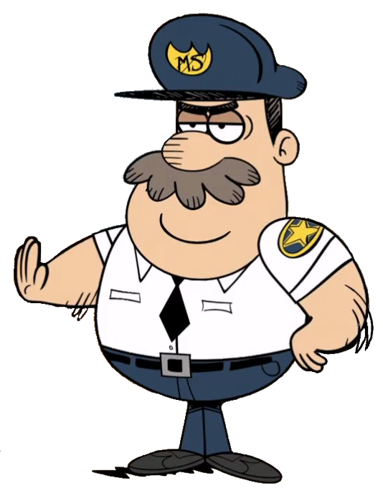
Amygdala acts as our smoke alarm
Search
Alert
Mobilize
Notes:
In the movie Mall Cop, Paul Blart played by Kevin James is trying to issue a citation to an older gentleman on a scooter for reckless driving in the mall. The amygdala is very similar to Paul Blart. While the mall cop is convinced this man on the scooter is a risk, if you’ve seen the movie, it is clear he is not. The mall cop does not know the difference in real and perceived danger and so he is over functioning in his role as a protector. This is often what our amygdala does for us.
I want you to imagine that you each have a (CLICK) mall cop inside of your brain. His name is SAM this stands for (CLICK)search, (CLICK)alert, and (CLICK)mobilize. This is what he has been created to do. Like the amygdala, he serves an import function when you are in danger (his job is to protect) but when he is reacting to perceived danger, such as, failing an exam or getting a parking ticket, you will need to tell him to stop sounding the alarm and calm down.
Example: fire detector
***What are some of the dangers you are facing right now? Have you felt the need to run, fight, or hide? What symptoms have you felt in your body?
*Image courtesy of Kristie Collins
*Mall cop image courtesy of https://theloudhouse.fandom.com/wiki/Mall_Cop_Captain

Slide 7
Notes:
This image is called a window of tolerance. (CLICK) Between the 2 lines is the window where your emotions can be tolerated and regulated. In this window you are engaging your higher brain or your human brain. It is here that you are most rational. The yellow boxes represent the point were you start to become dysregulated but you still have some control. (CLICK) Above the line you will proceed into a state of Hyper arousal. This is your fight or flight response. Here you might experience anger, feeling overwhelmed, increases sensations, flooded emotional reactivity, hyper vigilance, intrusive imagery, flashbacks, disorganized cognitive processing. This is your sympathetic response and it displays symptom of anxiety. (CLICK) Below the line is Hypo arousal. This is your freeze response. Here you might feel zoned out or numb, time can go missing, your might have absence of sensation, disabled cognitive processing, and/or reduced physical movement. These symptoms are more representative of depression.
*Image courtesy of Kristie Collins

Slide 8
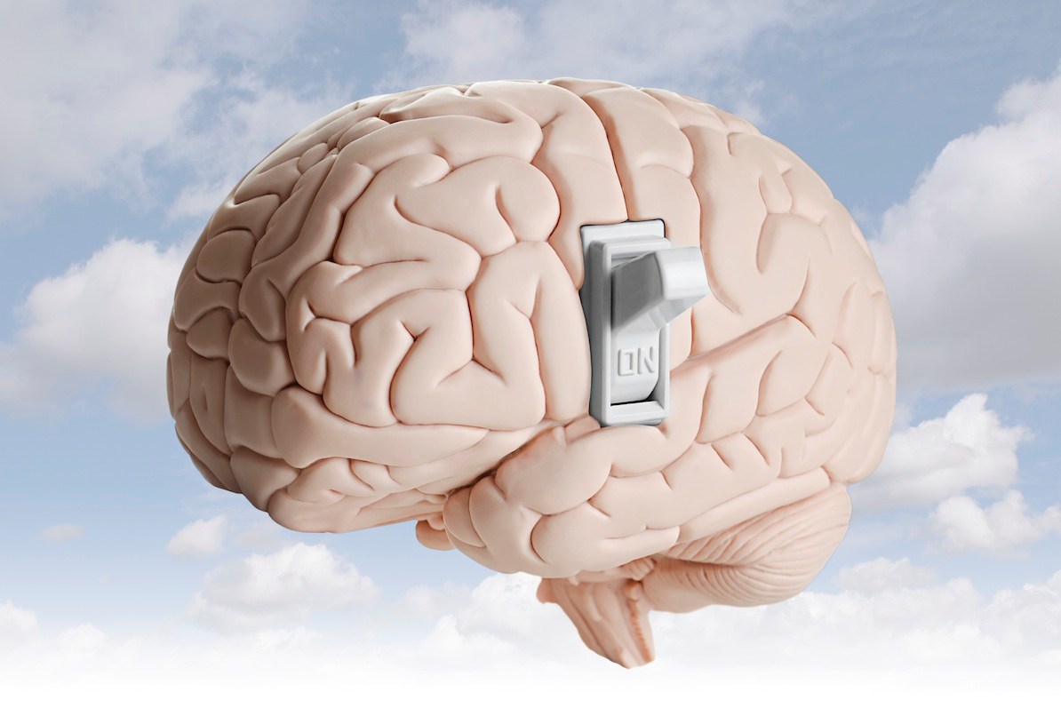
You can learn to manage your stress
Whether you were born with a brain that tends to create anxiety or acquired your anxiety problems as a result of life experiences, you can cope with anxiety. We have proof
through science that a positive
environment can turn off bad genes.
-Rewire Your Anxious Brain by Pittman and Karle
Notes:
Whether you were born with a brain that tends to create anxiety or acquired your anxiety problems as a result of life experiences, you can cope with anxiety. We have proof
through science that a positive
environment can turn off bad genes.
-Rewire Your Anxious Brain by Pittman and Karle

Slide 9
https://www.ttuhsc.edu/centers-institutes/counseling/resouces.aspx
Self
talk
Self
care
Aerobic exercise
Positive, Negative, Neutral
The inner dialogue we have going in our head every waking moment
Proper sleep
Mindfulness practices
Connected relationships
Humor
Gratitude
Spiritual practices and disciplines
What you tell yourself becomes your reality
Talk to yourself the way you talk to someone you love
Intentionality
Notes:
Now, back to managing stress.
(CLICK) Self Talk and (CLICK) Self Care are the solution to mental health.
(CLICK) Self talk is the inner dialogue we have going in our head every waking moment, it is either positive, negative, or neutral. This is important because what you tell yourself, becomes you reality. An article in Psychology Today says that 70% of our thoughts are negative. Dr. Leaf in her book, Switch on Your Brain, says that 75-98% of mental, physical, and behavioral illness comes from our thought life. An important tip here is to talk to yourself the way you would talk to someone you love.
(CLICK) Self Care can include many things but a good place to start is aerobic exercise (15-18 minutes can have the same affect as an SSRI or antidepressant with the effects lasting up to 6 hours, proper sleep (most of us need 6-8 hours each night), mindfulness practices (we will discuss this in a following slide), connected relationships (this might prove challenging during a quarantine but is always important), humor, gratitude, and/or spirituality. Most importantly, each of these will require (CLICK) intentionality. I would like you to go to our resource page. The website address is in the top right hand corner of this slide. Now, pause the presentation and take a few minutes to look around. See if you can identify one resource you might be able to use today. ***What did you find helpful on the resource page?
Image courtesy of Kristie Collins
Dr. Raj Raghunathan, “How Negative Is Your ‘Mental Chatter’?,” Psychology Today, October 10, 2013
Dr. Caroline Leaf, Switch On Your Brain: The Key to Peak Happiness, Thinking, and Health

Slide 10

Conscious vs. subconscious Mind
Conscious Mind - 5 to 7 thoughts every second
Subconscious Mind – 2 million bits of info every second
Problem: Much of our negative thinking happens in the subconscious mind while we are unaware
Notes:
I want to explain why self talk gets out of control so easily. Where the (CLICK) conscious mind can process 5 to 7 thoughts every second, the (CLICK) subconscious mind can process 2 million. (CLICK) Much of the negative thinking happens in the subconscious mind while we are unaware. Like an iceberg, the damage is often done by what lies under the water.
*image courtesy of https://axisintervention.com/whats-underneath/iceburg/

Slide 11
Anxiety-Igniting Thought | Coping Thoughts
It's no use trying. Things will never work out for me. | I'm going to try, because then there's at least a chance that I'll accomplish something.
Something's going to go wrong. I can feel it. | I don't know what's going to happen. These kinds of feelings have been wrong before.
I need to focus on this thought, doubt, or concern. | Cortex, you've spent too much time on this and need to move on.
I must be competent and excel at everything I do. | No one is perfect, I'm human and expect I'll make mistakes at times.
Everyone should like me. | No one is liked by everyone, so I'll encounter people who don't like me.
Notes:
Here are a few examples of anxiety-igniting thoughts vs. coping thoughts. A thought that might ignite my anxiety is: Things are never going to be the same! An example of a coping thought is: Things may not be the same but hopefully some will be better. I am ok today. Pause the presentation and take a minute to read each of these. ***Can you think of more examples?

Slide 12
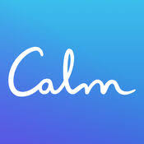

Mindfulness
Definition of mindfulness: maintaining a moment-by-moment awareness of our thoughts, feelings, bodily sensations, and surrounding environment.
Tip: Pay attention to what you pay attention to!
Resources:
Notes:
Lets take a closer look at mindfulness. I think it important to understand mindfulness, because the benefits are amazing. (click) Mindfulness is simply maintaining a moment-by-moment awareness of our thoughts, feelings, body sensations, and the surrounding environment.
Anxiety is caused by the past and all the things we can’t change or the future and all the things we can not predict or control.
Mindfulness is being in the here and now which is much less stressful than living in the past or the future.
(CLICK) One tip is to: Pay attention to what you pay attention to.
(CLICK) Here are some resources for mindfulness. These apps provided guided mediation, if you are new to mindfulness. They are both free to install and have basic packages. A monthly or yearly fee can be paid to extend the package. You will find more mindful resources on our website.

Slide 13
You can learn to manage anxiety
We have to take personal responsibility for the way we think, speak, and act. We need to stop being victims of our biology, of what happens to us and start being victors. -Dr. Caroline Leaf
Notes:
Dr. Caroline Leaf, in her book Switch on Your Brain, tells us, “We have to take personal responsibility for the way we think, speak, and act. We need to stop being victims of our biology, of what happens to us and start being victors.”

Slide 14
What is Available Through the Counseling Center at TTUHSC where I am employed?
Counseling Sessions (individual, couple, family)
  6 free sessions per employee per fiscal year
24-hour Crisis Line
Numbers to Call for an Appointment
  743-1327 or 1-800-327-0328
  Call the Counseling Center directly; no referral is needed
  www.ttuhsc.edu/counseling
*Due to the COVID-19 virus, The Counseling Center at TTUHSC now offers telehealth counseling, using a HIPPA-compliant Zoom platform.
Notes:
If you need more help managing your stress, anxiety or depression, I would recommend you seek the services of a mental health professional. If you are an employee of TTU or TTUHSC, you have 6 free confidential counseling sessions per fiscal year thru the Employee Assistance Program also known as EAP. You can share your benefit with spouse, partner and children (18 or younger) living in your home. You can schedule 50 minute appointments Monday thru Thursday 9-6:30 and Friday 9-5. Our number also serves as a 24 hour crisis line. I would also recommend our website, where you can find many helpful resources under the resource tab or look at bio’s of each therapist under the Staff Counselor tab.
If you are not an employee of TTU or TTUHSC, check with your HR department to find out if you have access to an Employee Assistance Program, or contact your insurance provider to see which mental health professionals in your area are covered. Thank you for completing this lesson on stress management. I hope you are able to lower your stress using positive self care and self talk. Please feel free to reach out to us at number listed if you have any questions.

